Slide 1
Progress
Jinwoo

Slide 2
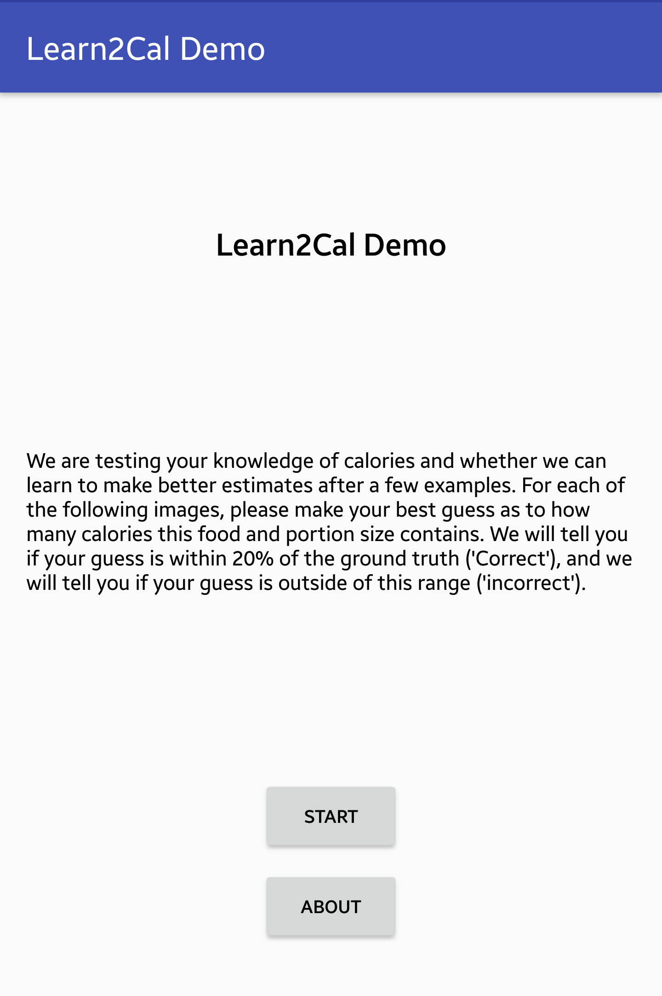
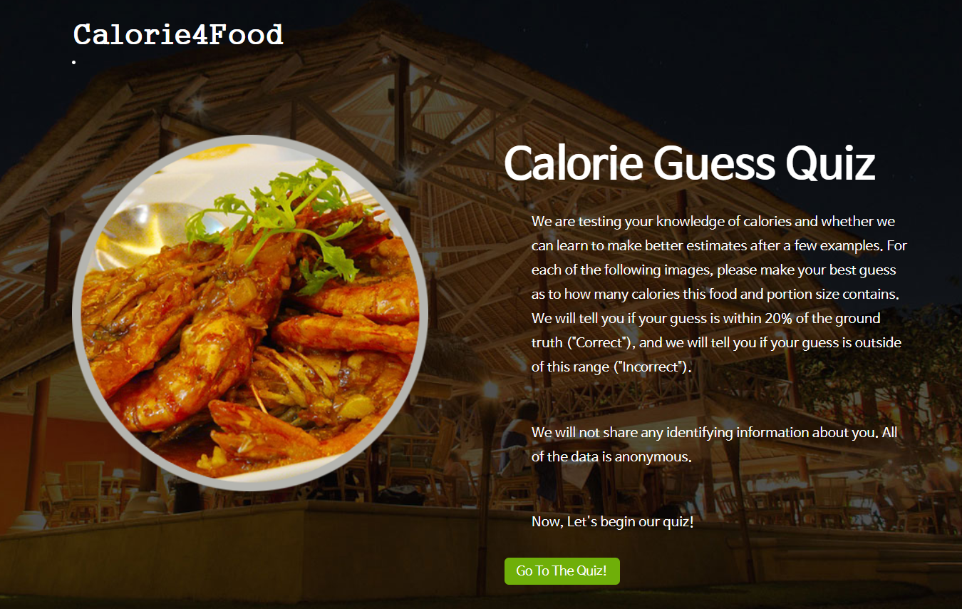
Main
Web
Mobile

Slide 3
Main
TODO
Background image.
Message.
Add [ABOUT] page.
Font size.

Slide 4
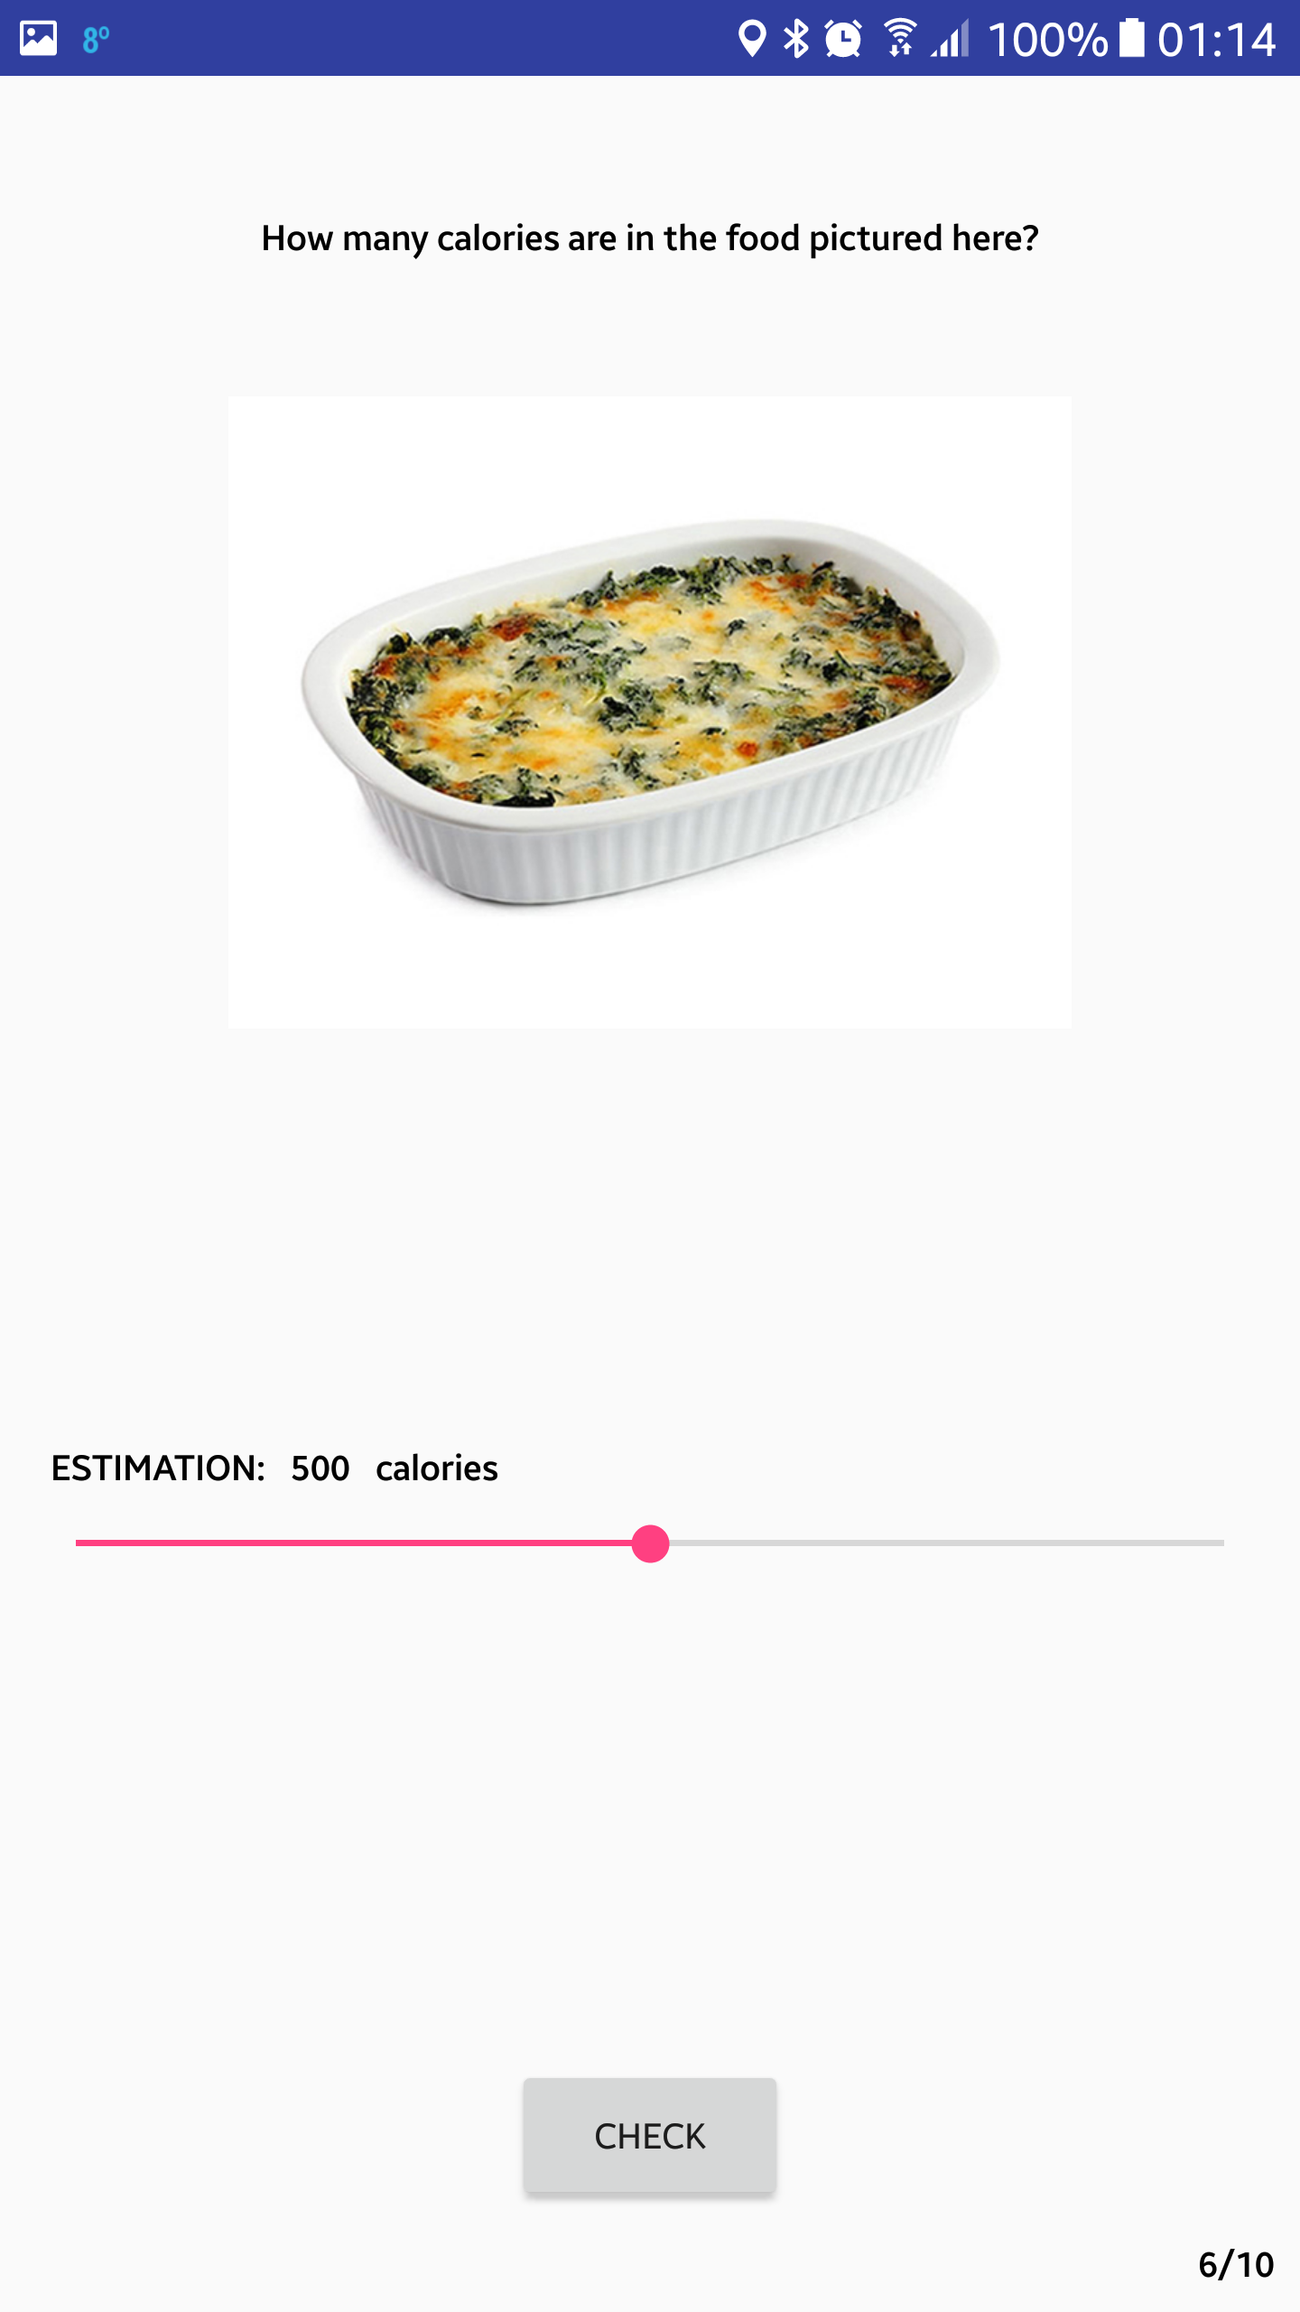
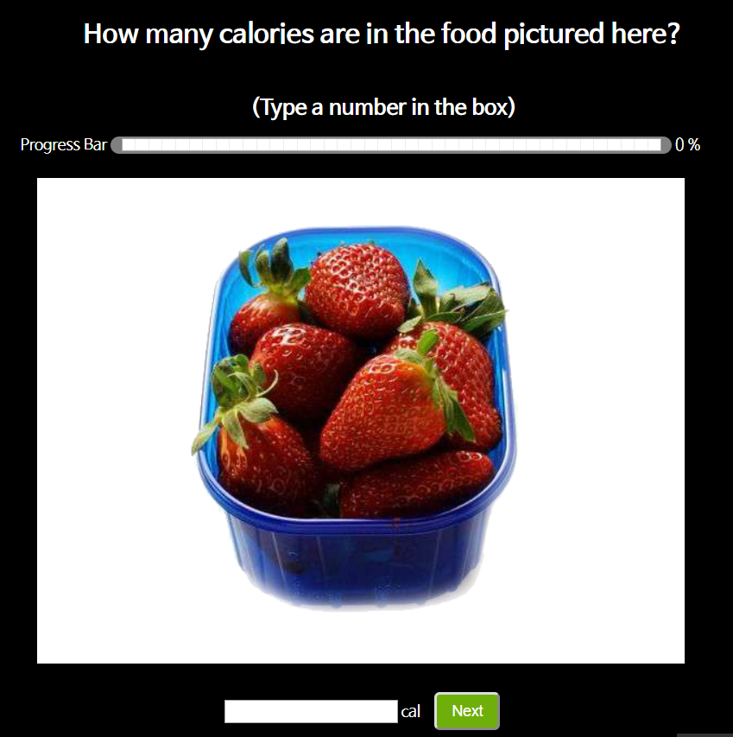
Quiz
Food image
SeekBar
Page

Slide 5
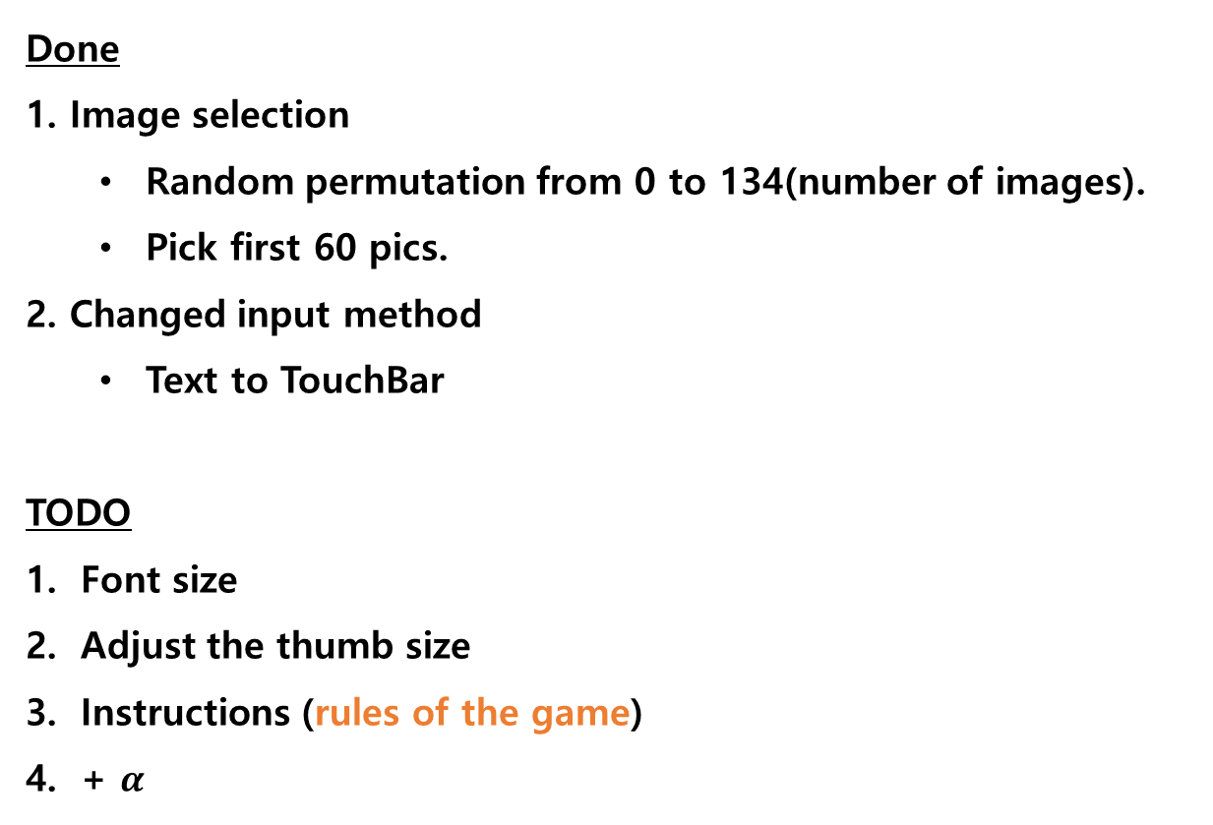
Quiz
Done
1. Image selection
Random permutation from 0 to 134(number of images).
Pick first 60 pics.
2. Changed input method
Text to TouchBar
TODO
Font size
Adjust the thumb size
Instructions (rules of the game)
+ $α$

Slide 6
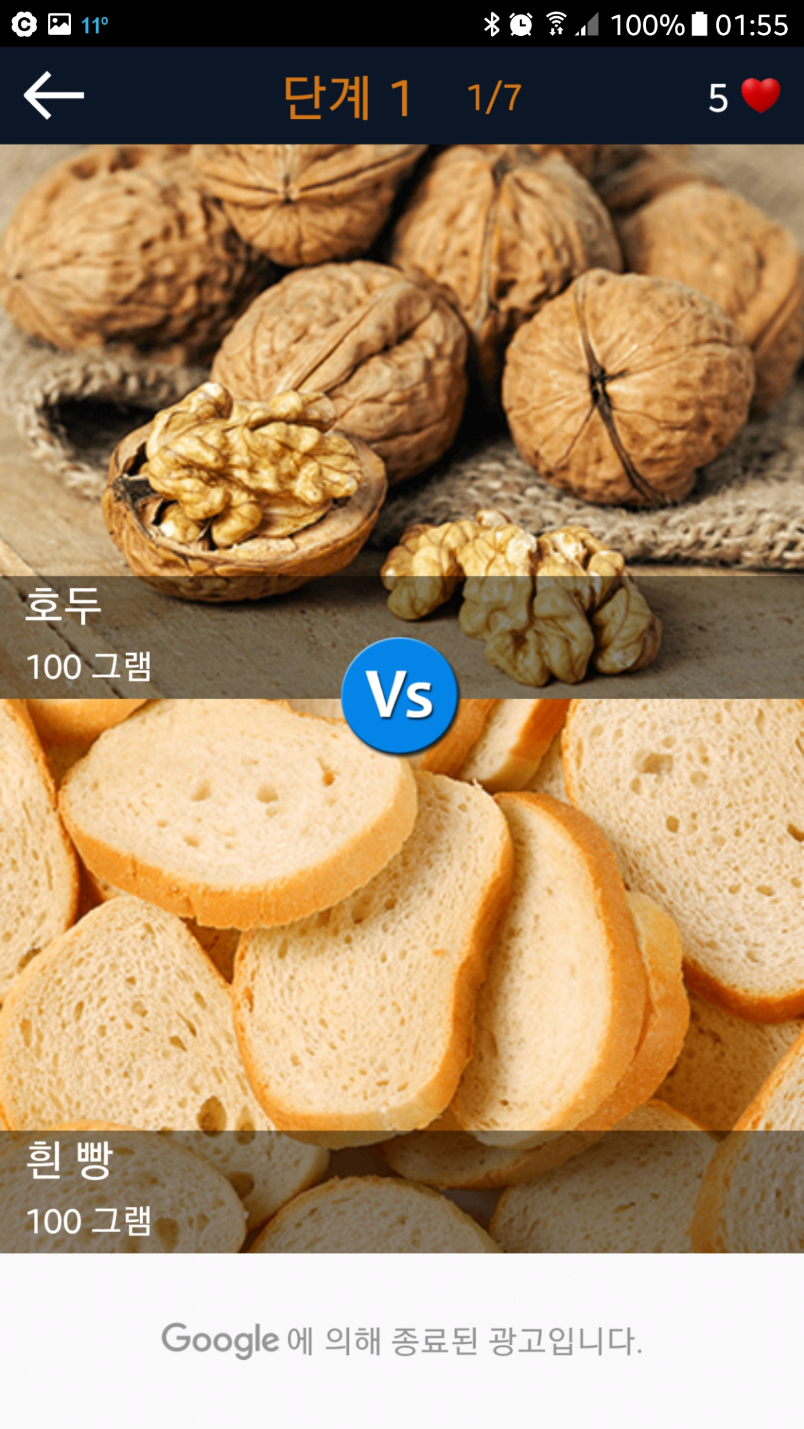
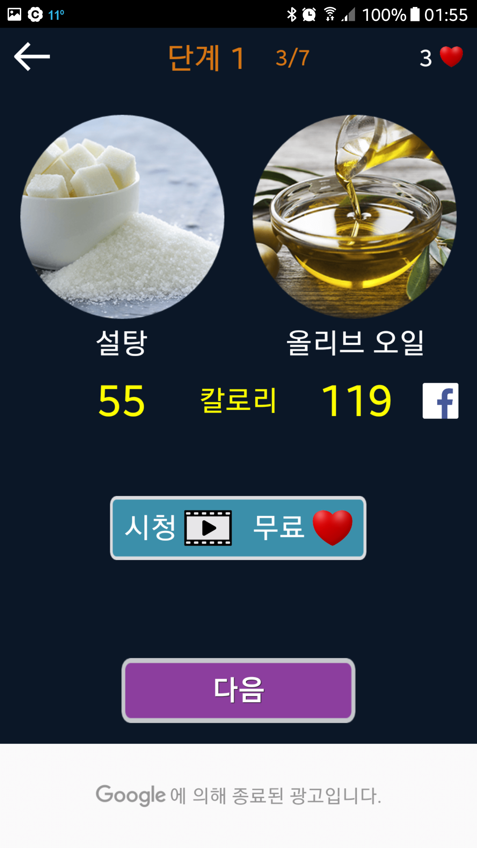
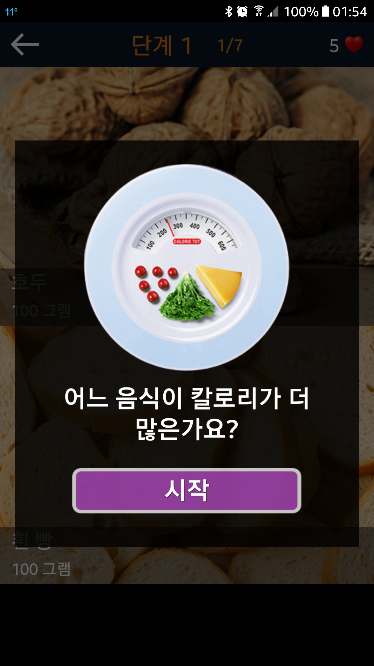
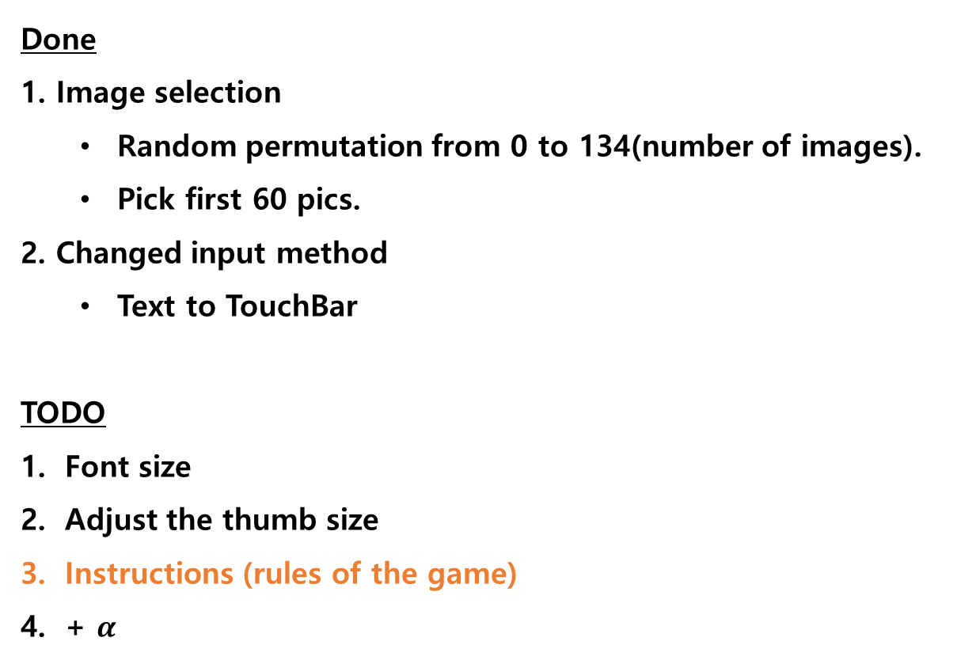
Quiz
Done
1. Image selection
Random permutation from 0 to 134(number of images).
Pick first 60 pics.
2. Changed input method
Text to TouchBar
TODO
Font size
Adjust the thumb size
Instructions (rules of the game)
+ $α$
QuizCalorie app on Google Play (Android appstore) Simple popup window to inform the rule of game. “Which food has more calories?”

Slide 7
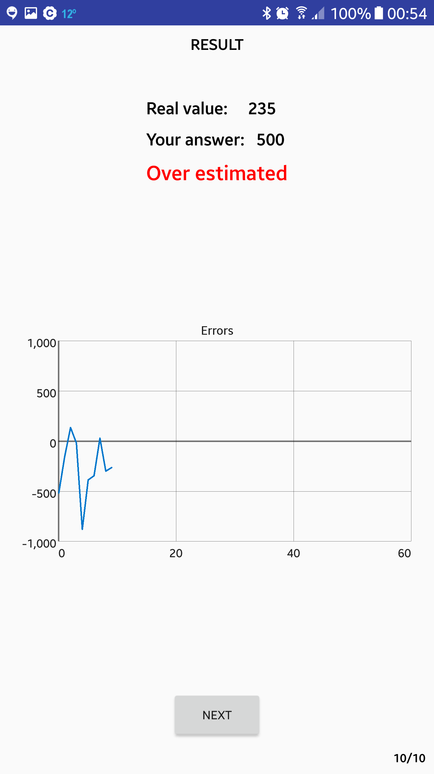
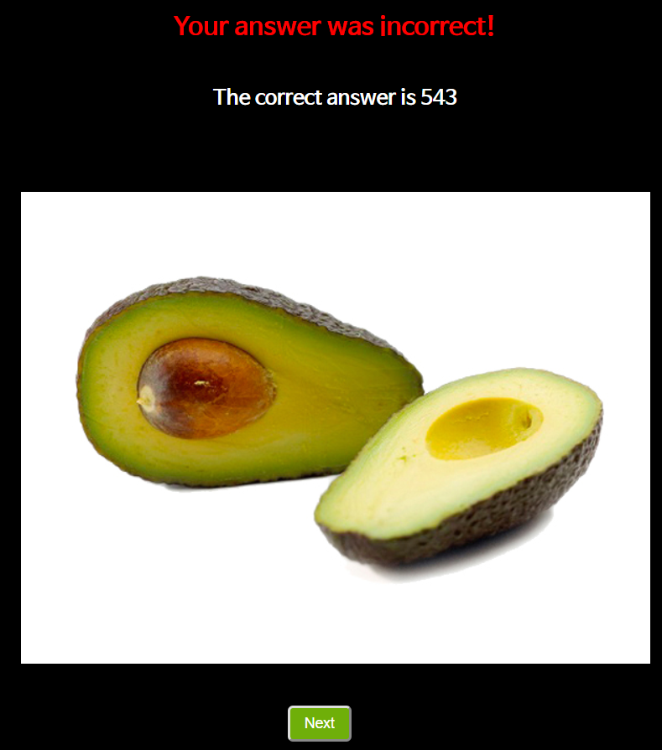
Score(feedback)

Slide 8
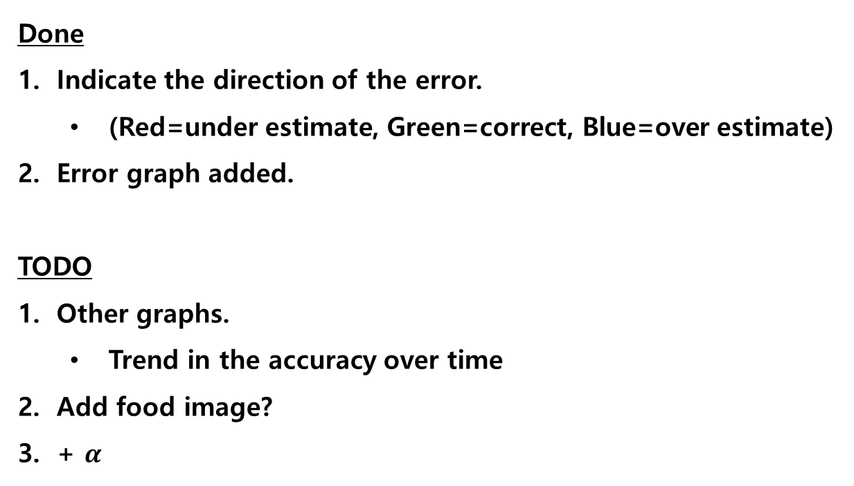
Score(feedback)
Done
Indicate the direction of the error.
(Red=under estimate, Green=correct, Blue=over estimate)
Error graph added.
TODO
Other graphs.
Trend in the accuracy over time
Add food image?
+ $α$

Slide 9
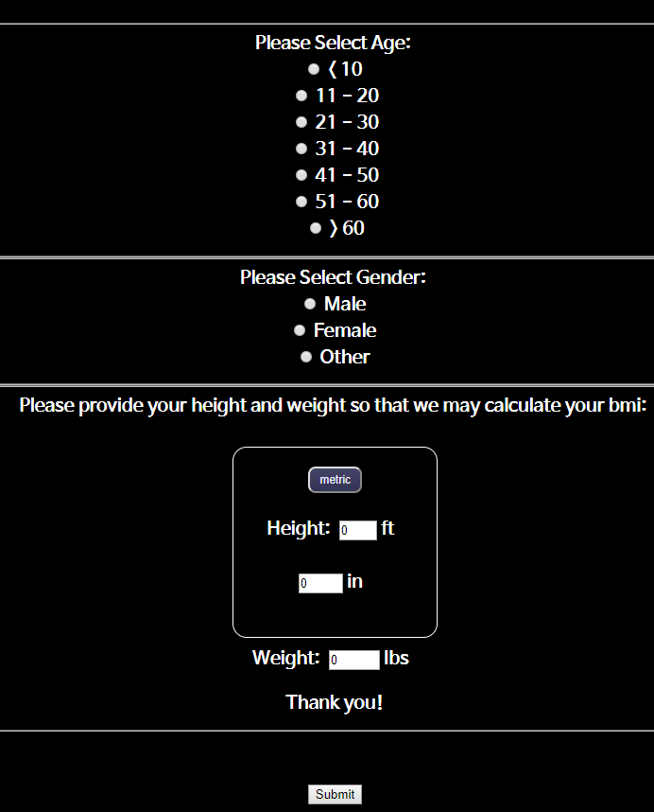
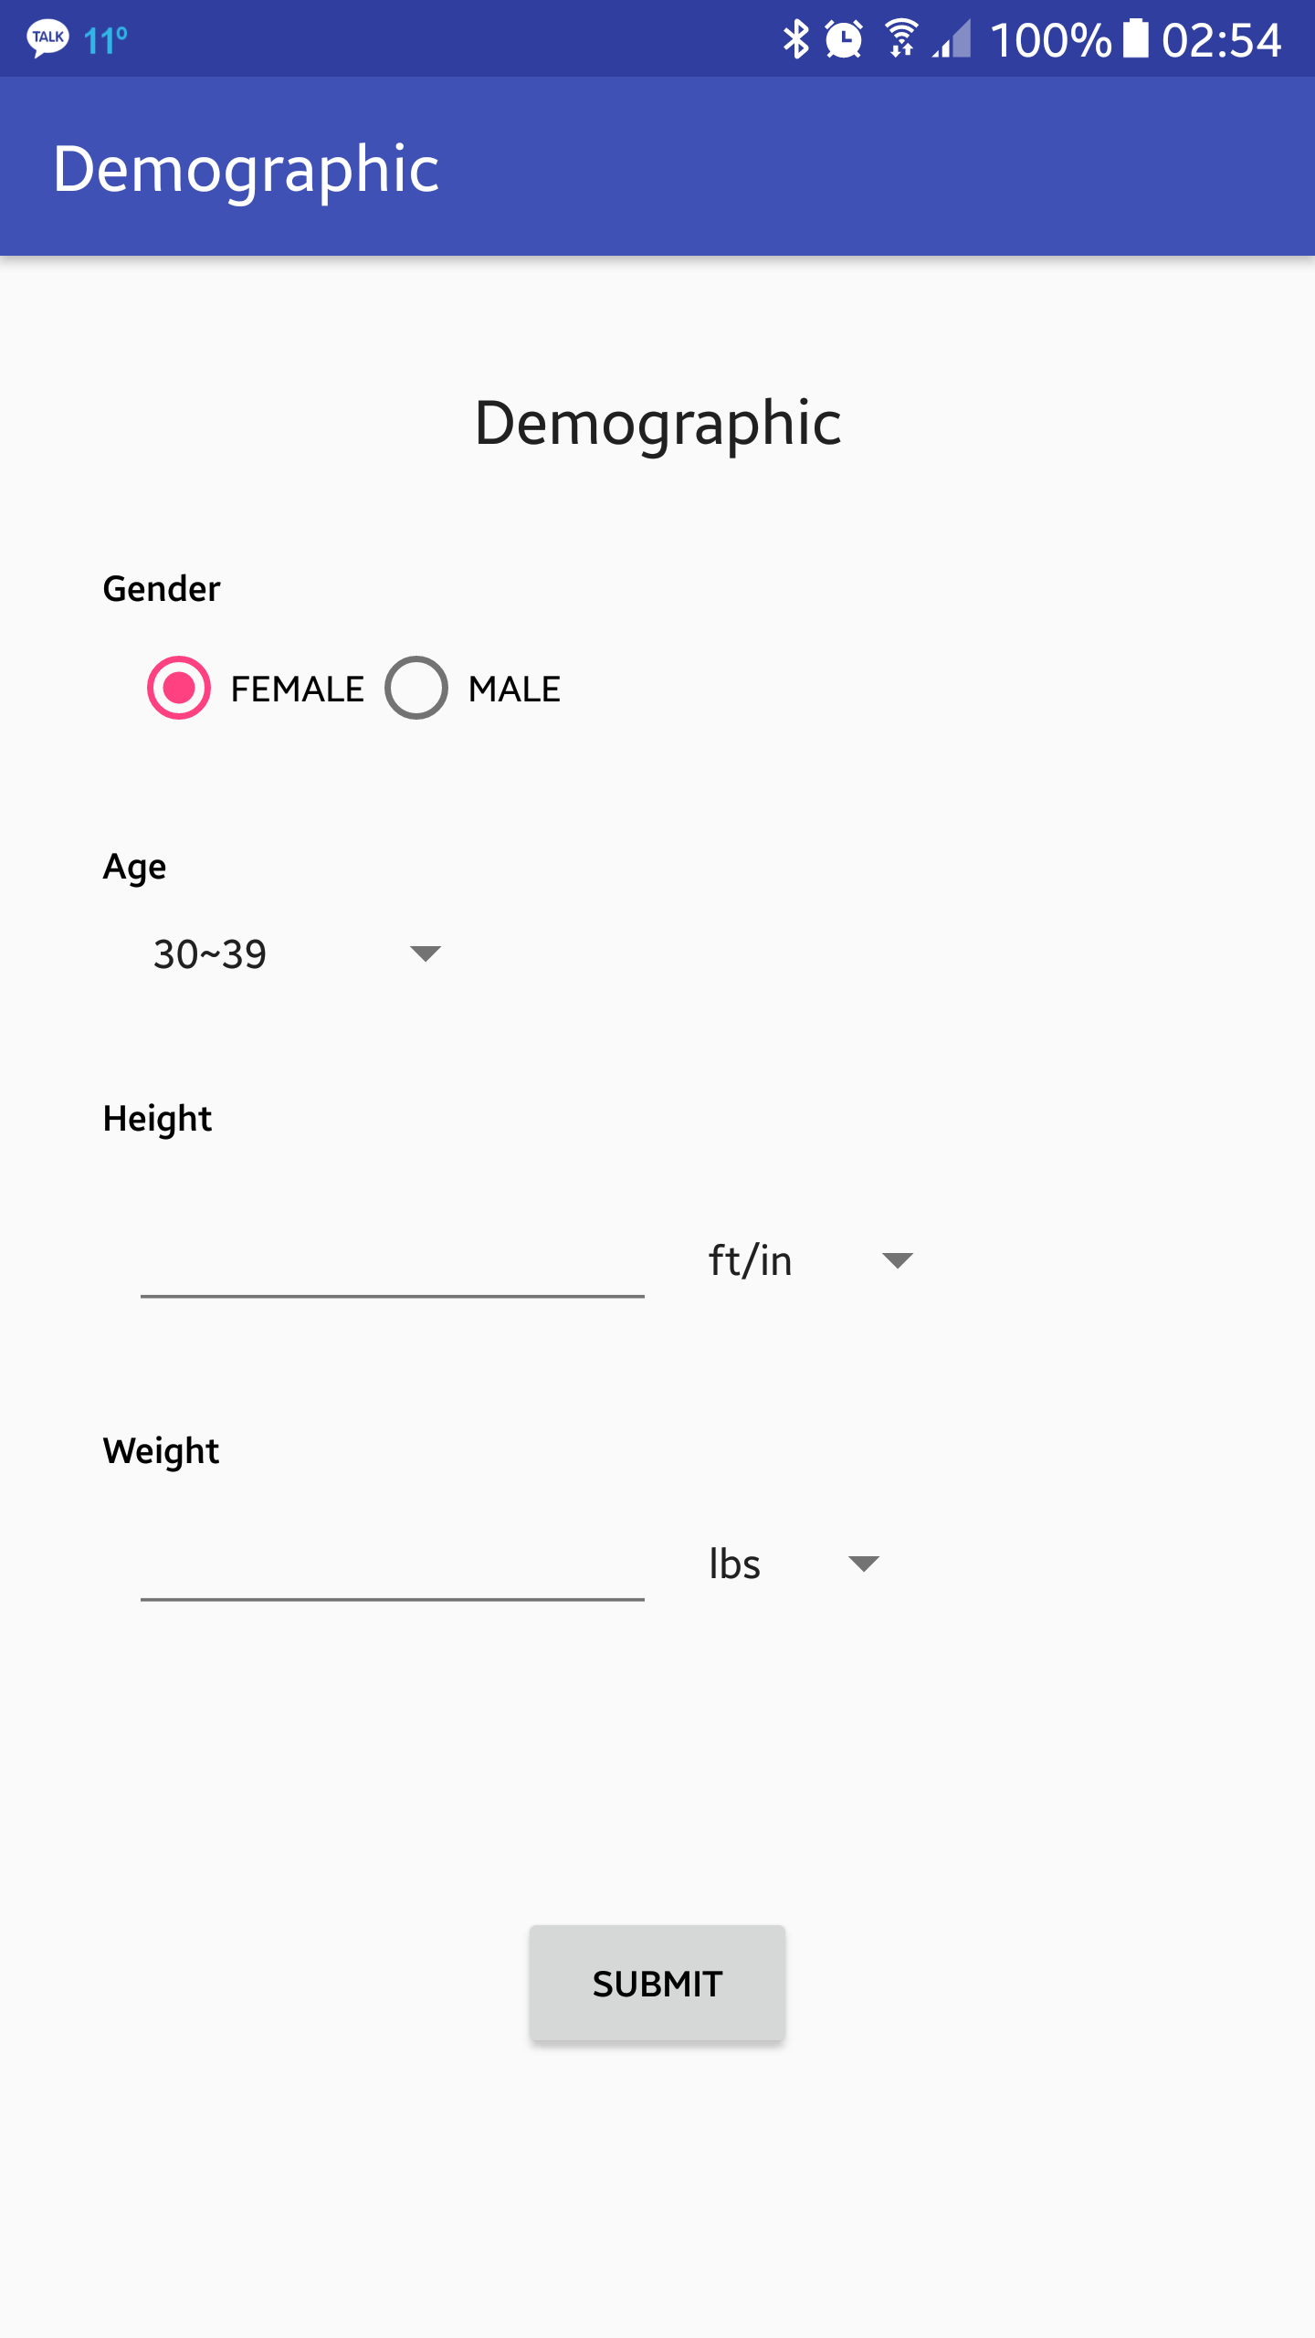
Demographic

Slide 10
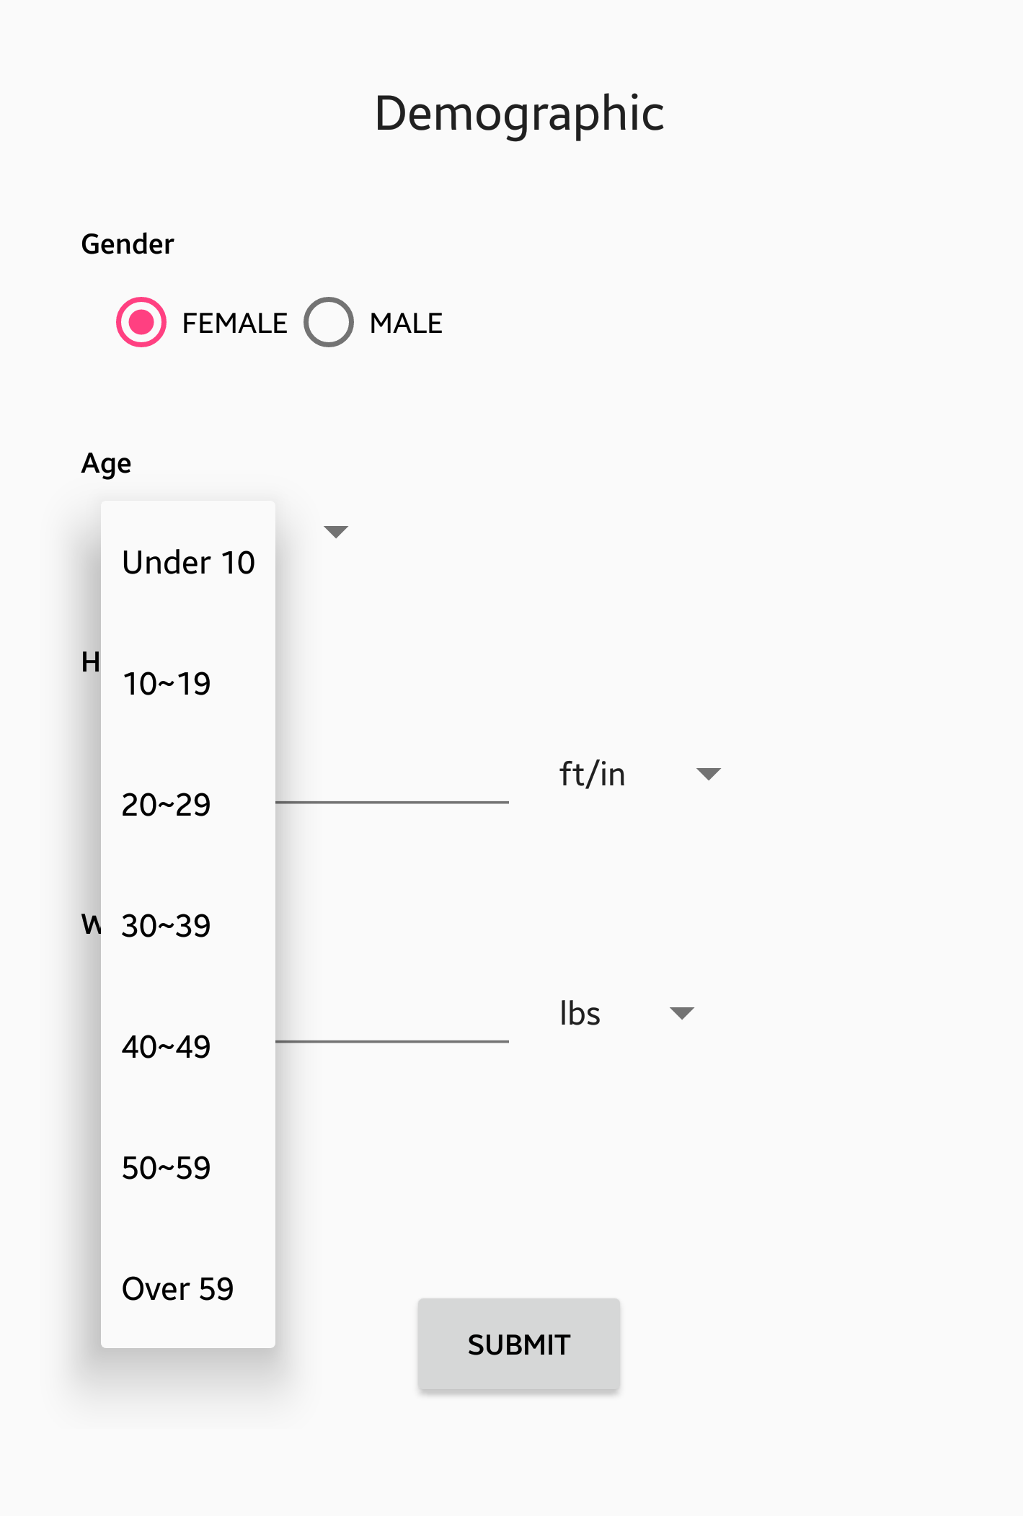
Demographic

Slide 11
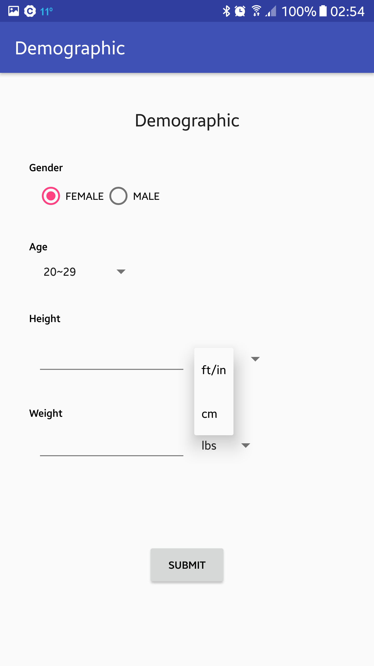
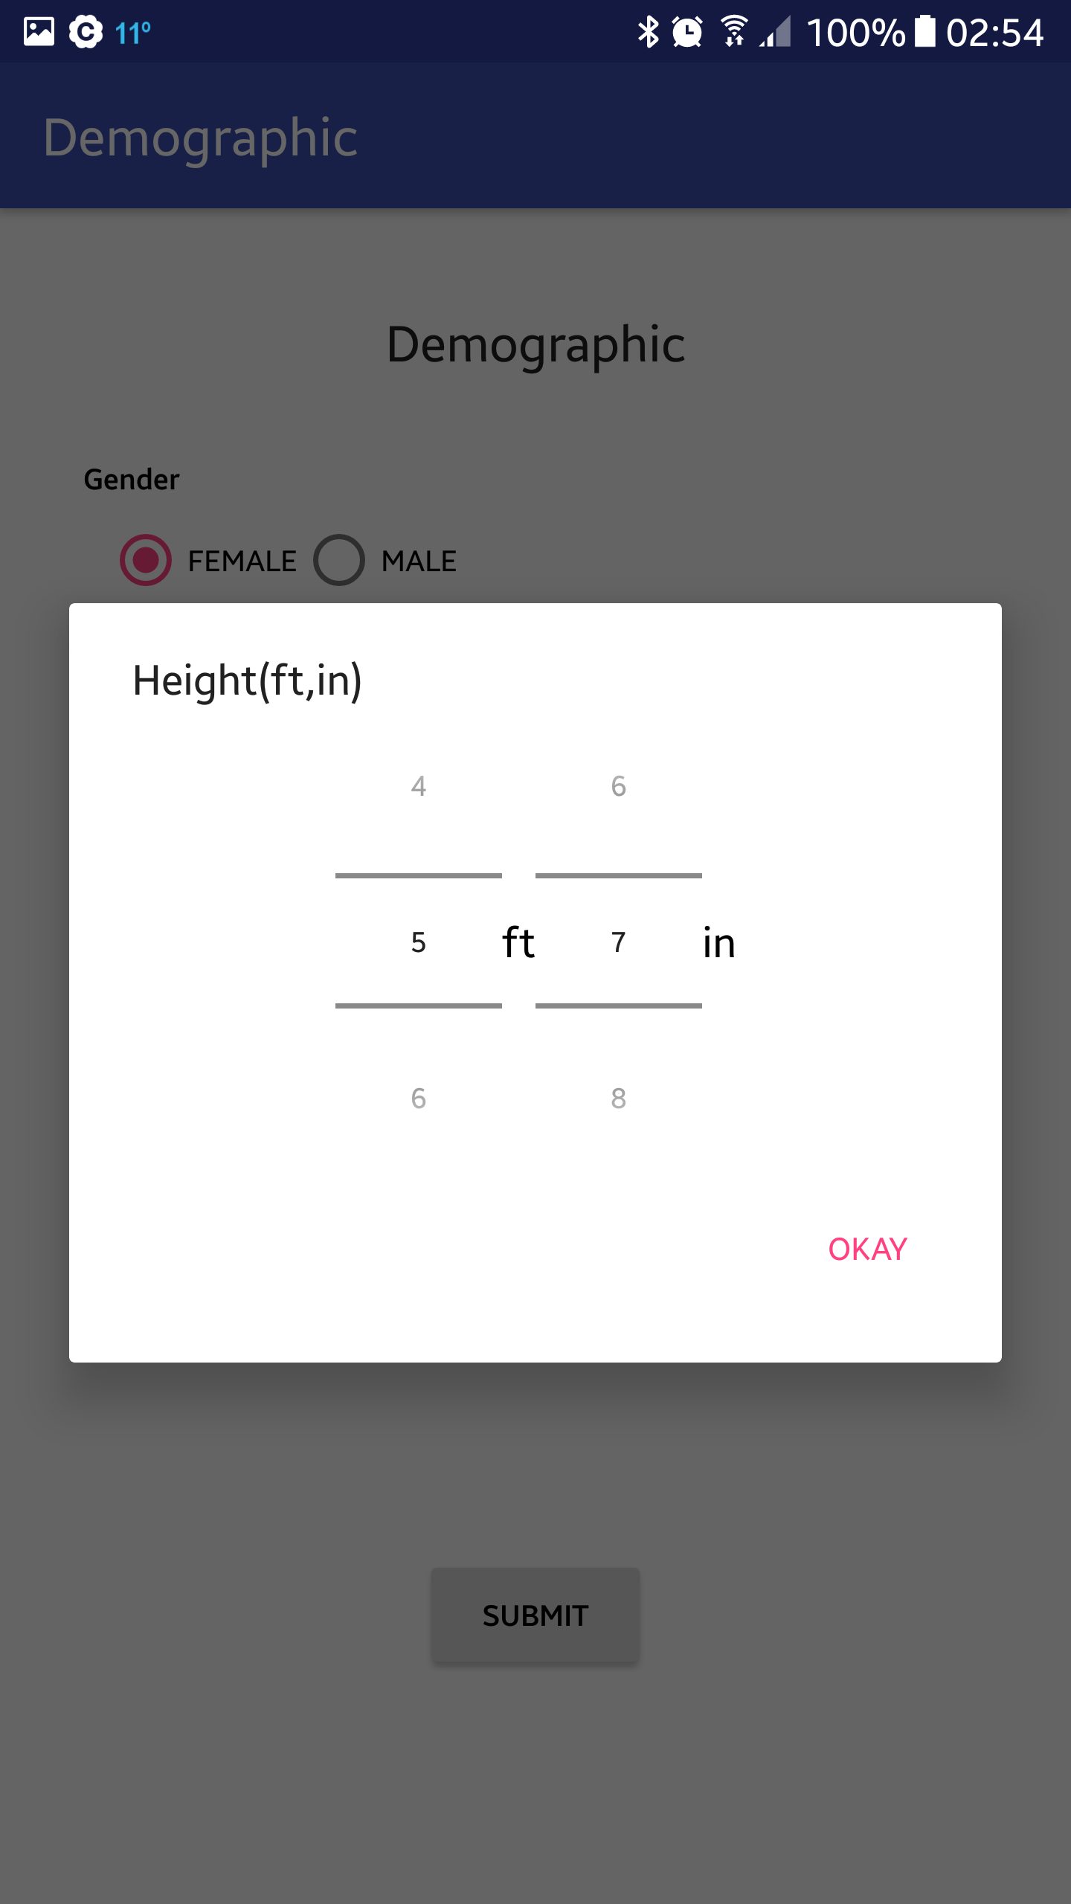
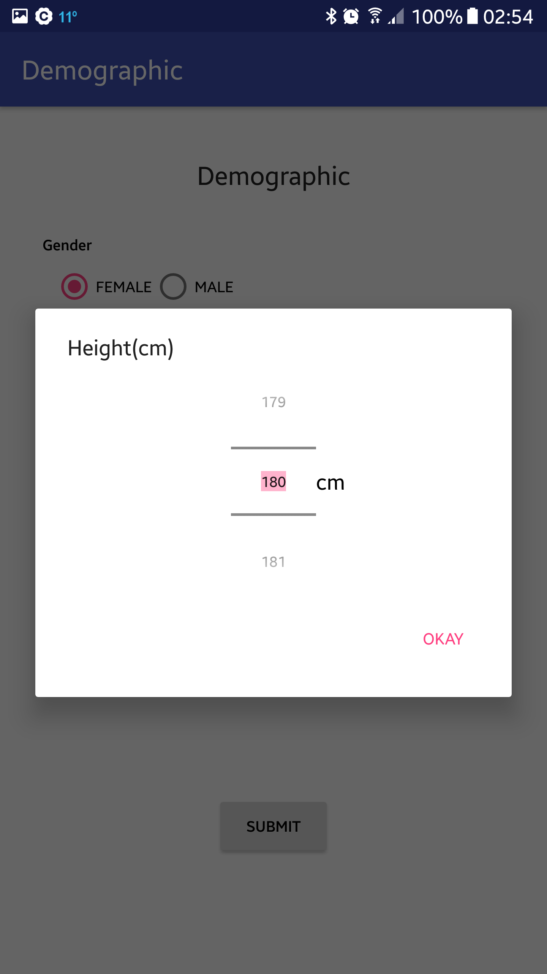
Demographic

Slide 12
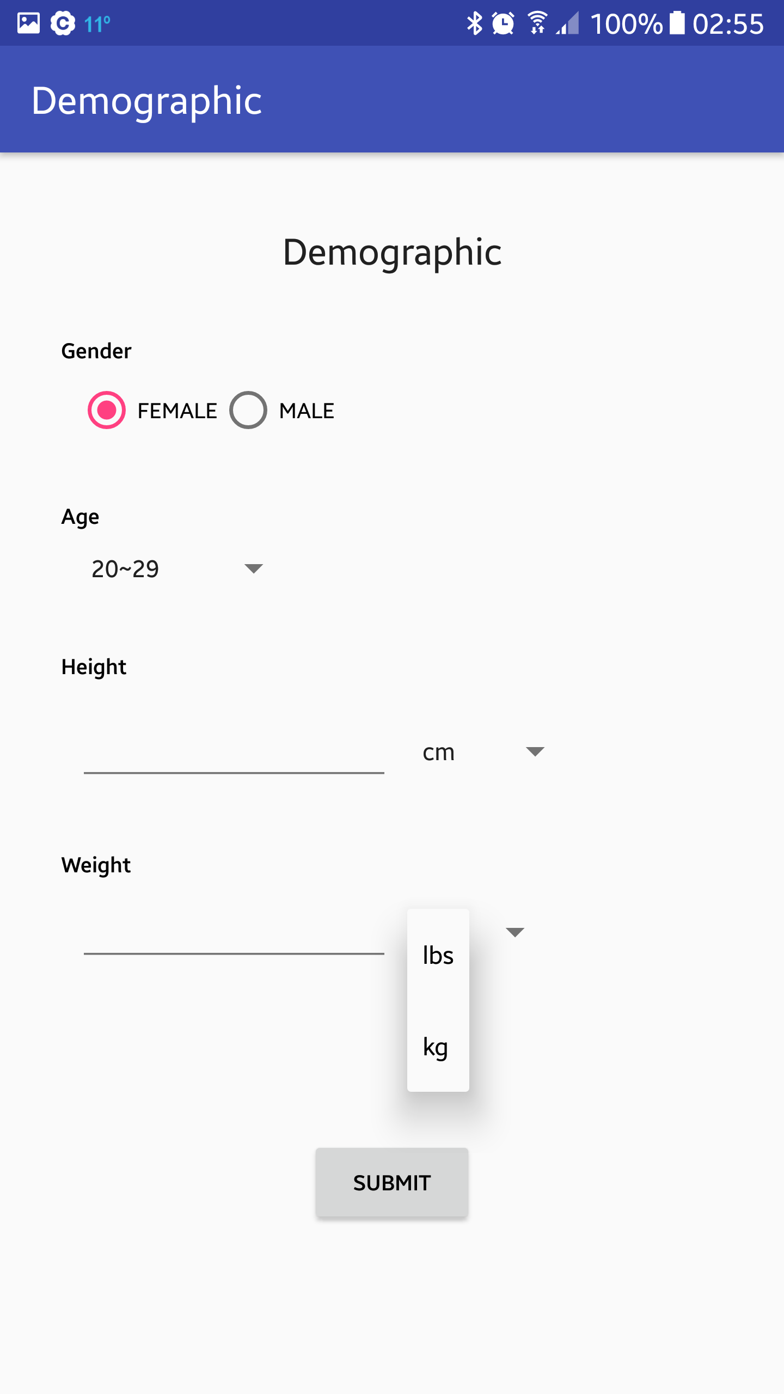
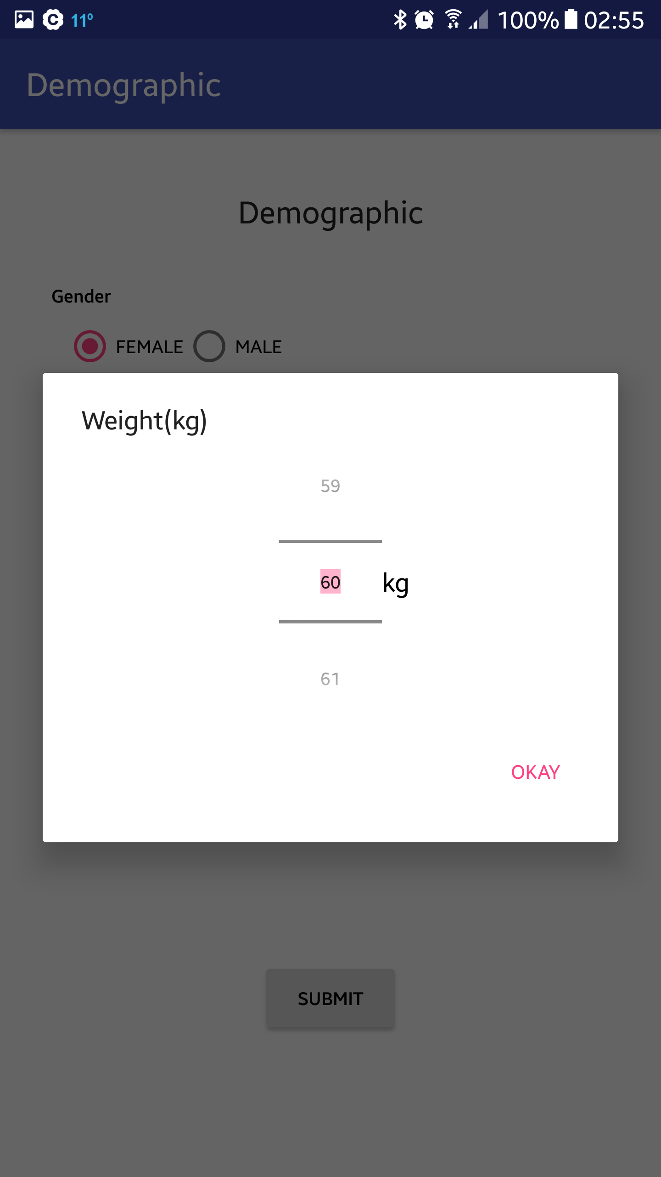
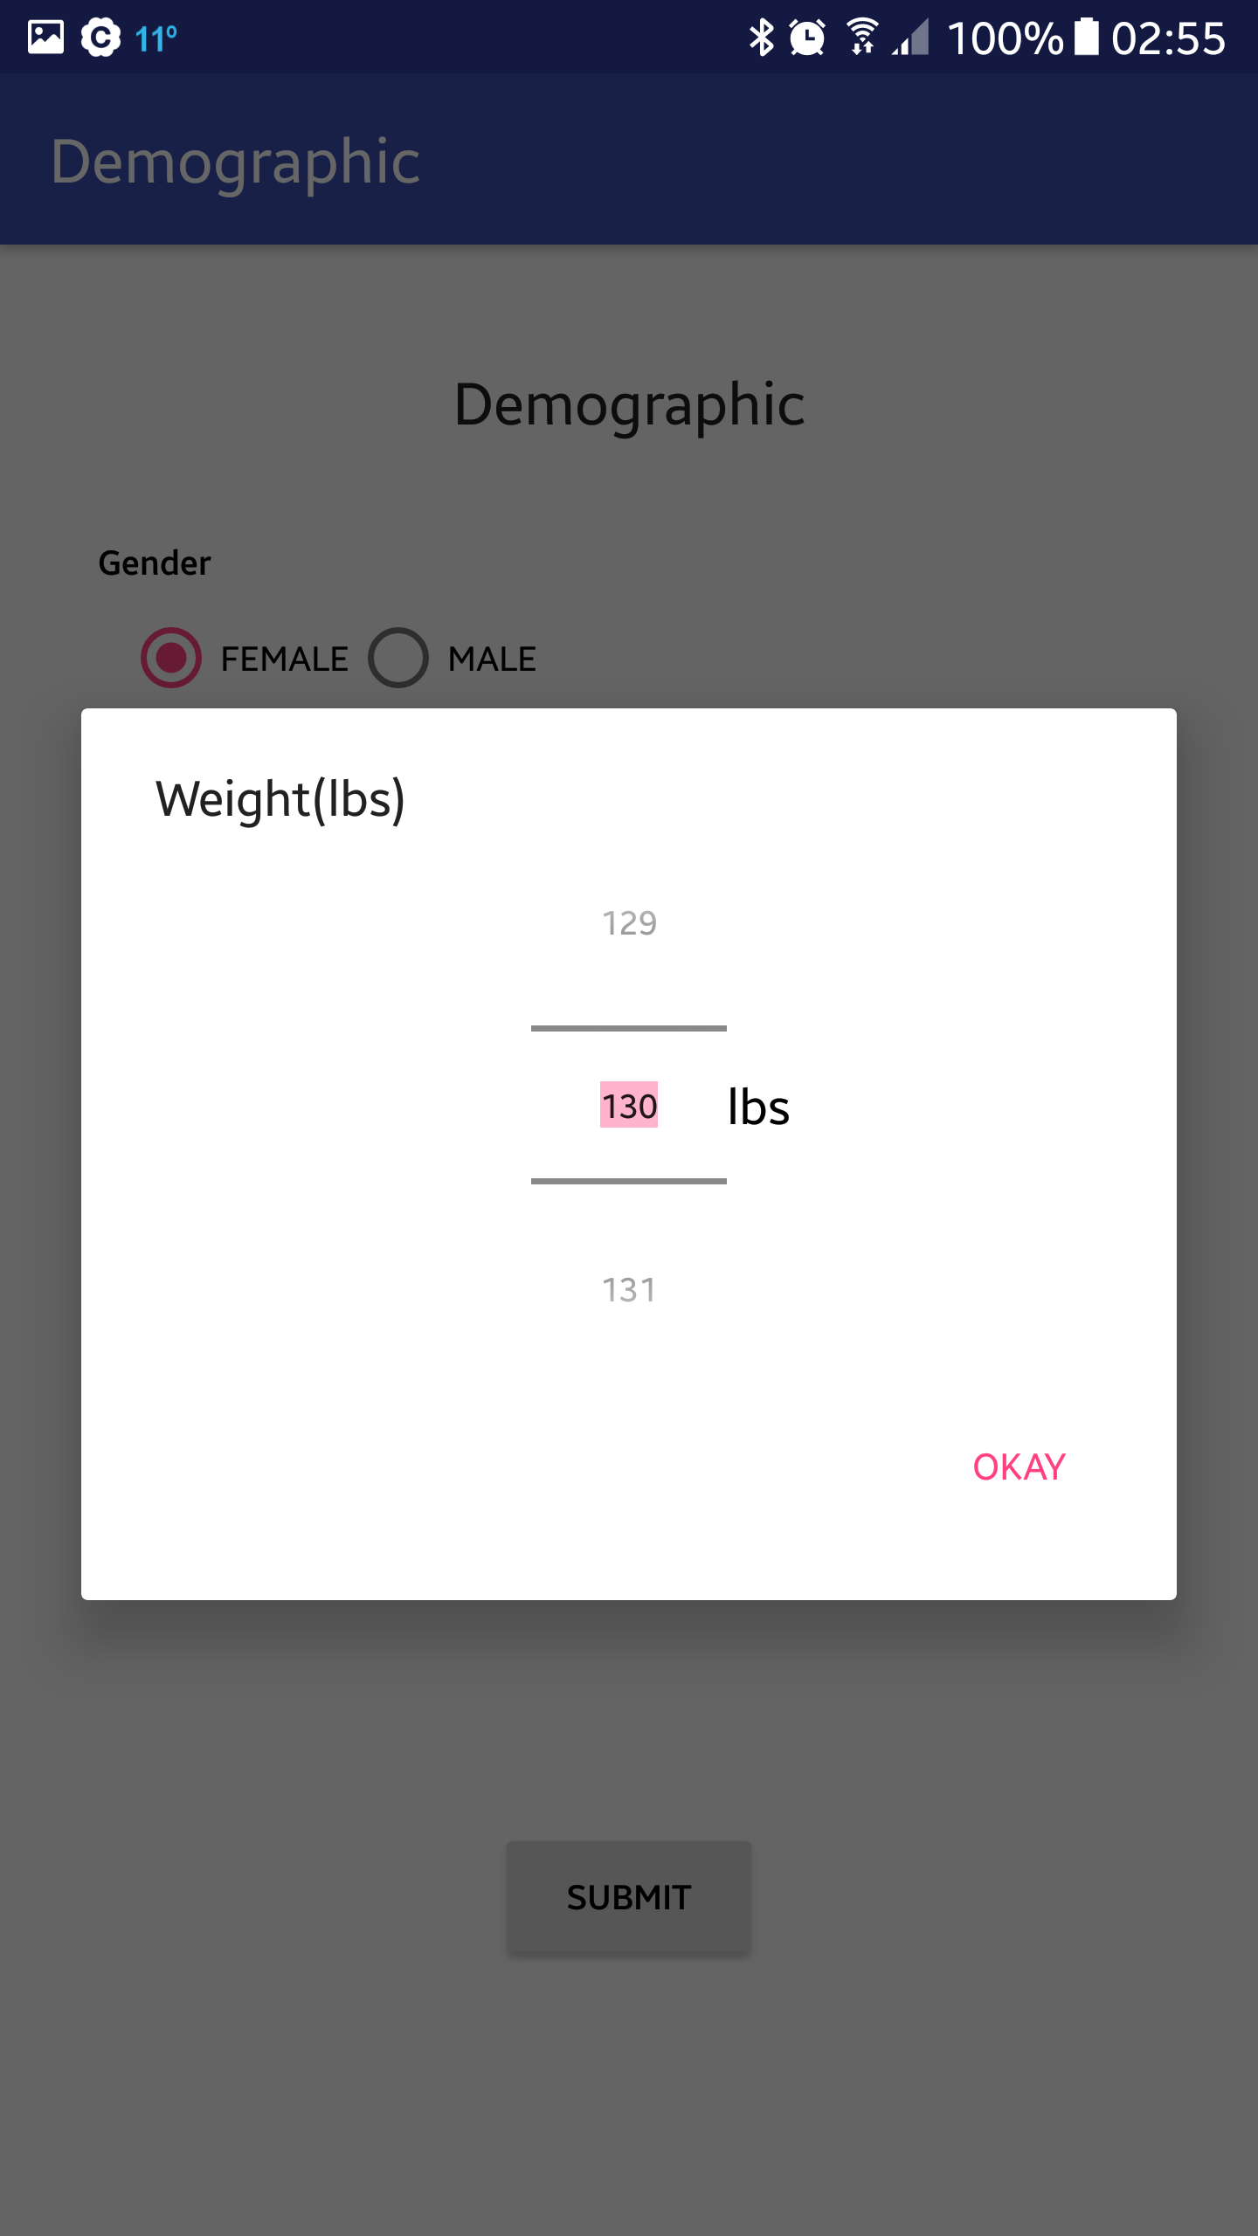
Demographic

Slide 13
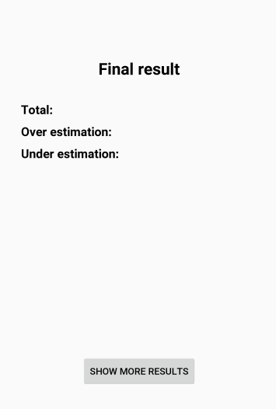
Demographic(plan)
Final result2
Detailed result based on statistics

Slide 14
App to server
What we have…
■ Estimations
■ Errors
□ Time per one quiz
■ Screen size (pixels; width & height)
■ Screen size (inches)
■ Where the data came from: app
■ Location(country)
■ OS (Android)

Slide 15
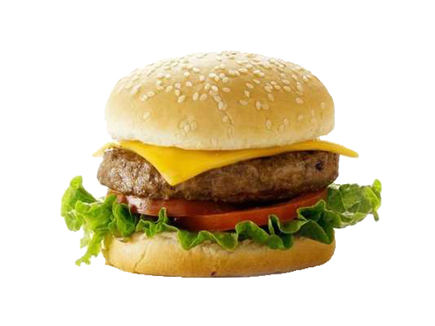

Decisions about caching?
Original
After
Resize 75%
Quality 80%
600x450px
450x338px
14.3mb
2.81mb

Slide 16
Others
Link the final page to database (send results)
Survey: scoring function
App icon
Time per one quiz
PHP, HTML
React native

